Slide 1

Thank You
This PowerPoint document contains the images that you requested.
Copyright Notice
All materials on this Site are protected by United States copyright law and may not be reproduced, distributed, transmitted, displayed, or otherwise published without the prior written permission of Wolters Kluwer. You may not alter or remove any trademark, copyright or other notice.
However, provided that you maintain all copyright, trademark and other notices contained therein, you may download material (one machine readable copy and one print copy per page) for your personal, non-commercial use only. Please refer to this link for further information on how to apply for permission for re-use
Any information posted to discussion forums (moderated and un-moderated) is for informational purposes only. We are not responsible for the information or the result of its practice.

Slide 2
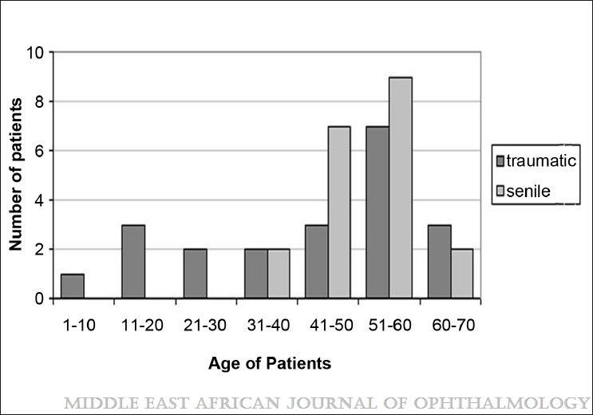
Figure 1
The Effects of Blunt Trauma and Cataract Surgery on Corneal Endothelial Cell Density
Yeniad, Baris; Corum, Isik; Ozgun, Cahit
Middle East African Journal of Ophthalmology17(4):354-358, Oct-Dec 2010.
doi: 10.4103/0974-9233.71604
The age distribution of patients with traumatic and senile cataract

Slide 3
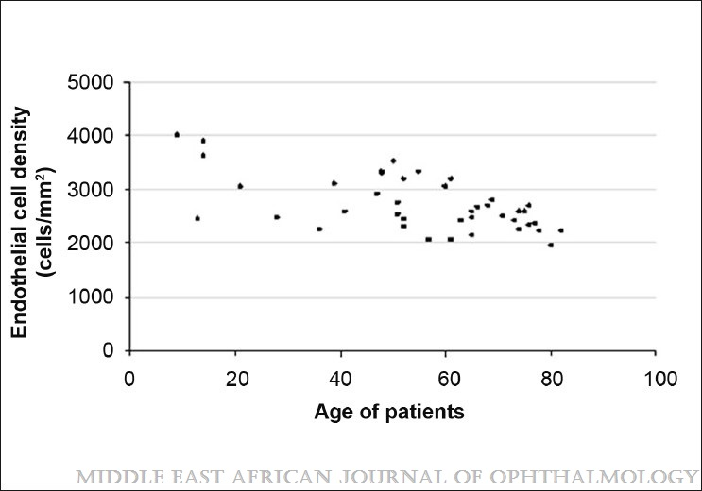
Figure 2
The Effects of Blunt Trauma and Cataract Surgery on Corneal Endothelial Cell Density
Yeniad, Baris; Corum, Isik; Ozgun, Cahit
Middle East African Journal of Ophthalmology17(4):354-358, Oct-Dec 2010.
doi: 10.4103/0974-9233.71604
The distribution of endothelial cell density in healthy eyes

Slide 4
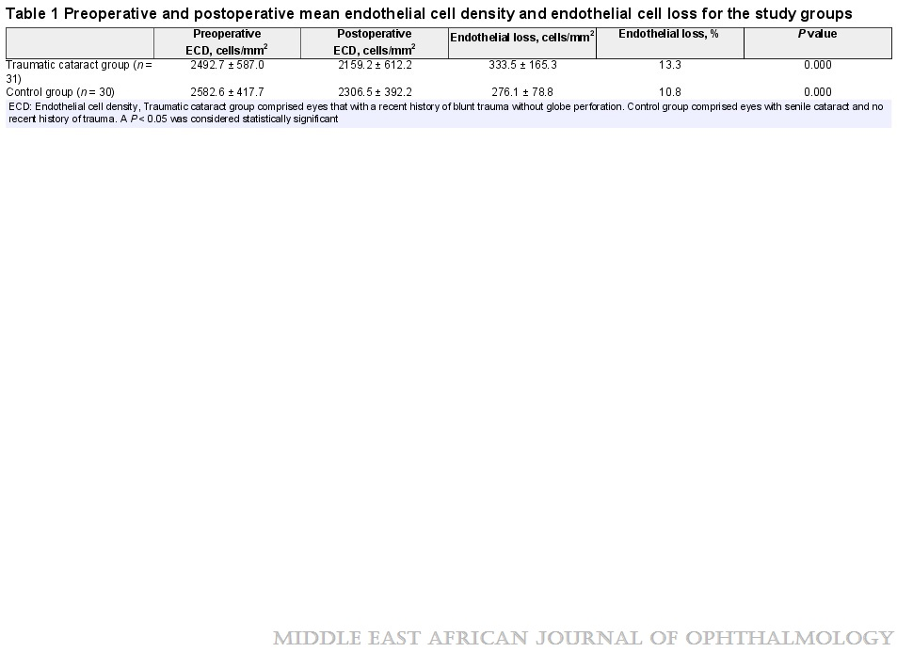
Table 1
The Effects of Blunt Trauma and Cataract Surgery on Corneal Endothelial Cell Density
Yeniad, Baris; Corum, Isik; Ozgun, Cahit
Middle East African Journal of Ophthalmology17(4):354-358, Oct-Dec 2010.
doi: 10.4103/0974-9233.71604
Preoperative and postoperative mean endothelial cell density and endothelial cell loss for the study groups

Slide 5
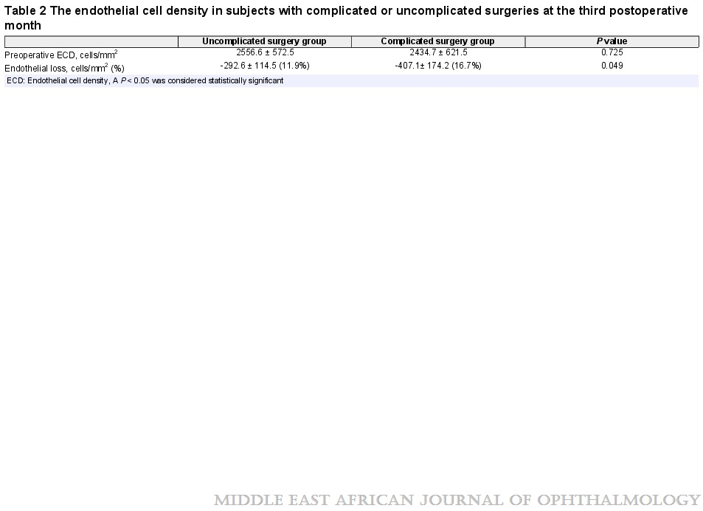
Table 2
The Effects of Blunt Trauma and Cataract Surgery on Corneal Endothelial Cell Density
Yeniad, Baris; Corum, Isik; Ozgun, Cahit
Middle East African Journal of Ophthalmology17(4):354-358, Oct-Dec 2010.
doi: 10.4103/0974-9233.71604
The endothelial cell density in subjects with complicated or uncomplicated surgeries at the third postoperative month

Slide 6
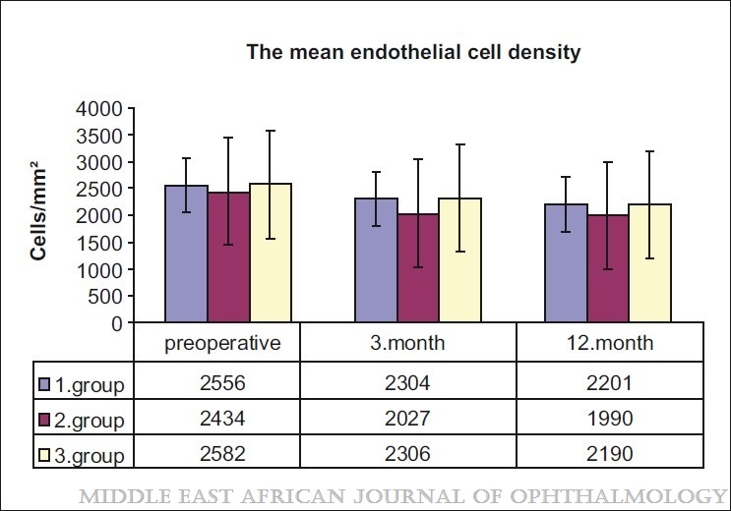
Figure 3
The Effects of Blunt Trauma and Cataract Surgery on Corneal Endothelial Cell Density
Yeniad, Baris; Corum, Isik; Ozgun, Cahit
Middle East African Journal of Ophthalmology17(4):354-358, Oct-Dec 2010.
doi: 10.4103/0974-9233.71604
The mean endothelial cell density of three groups preoperatively and postoperatively at third and twelfth months. (1) Group: Uncomplicated surgery subgroup, (2) Group: Complicated surgery subgroup, and (3) Group: Control group

